Slide 1


Slide 2



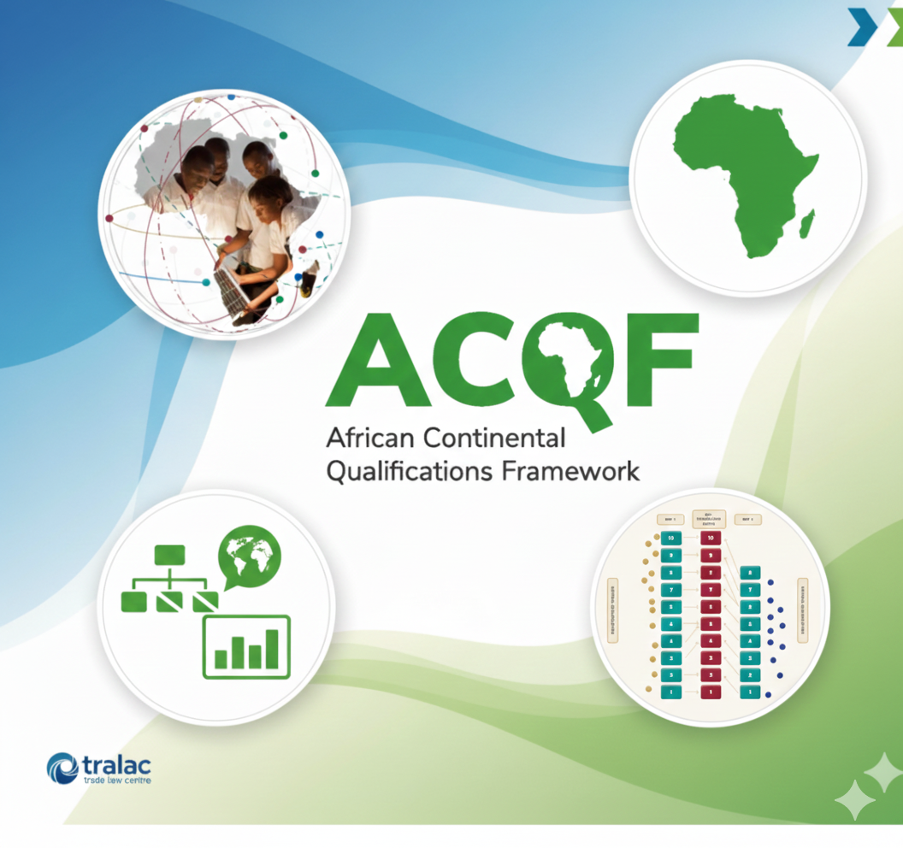

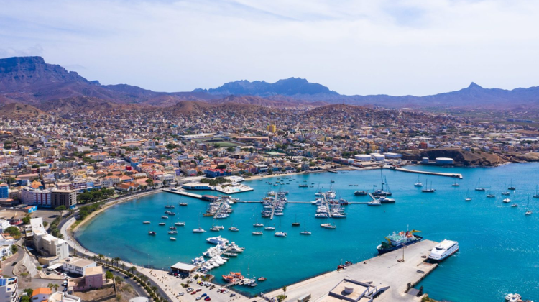
PRESENTATION ROADMAP
01
COUNTRY BACKGROUND
02
CABO VERDE QUALIFICATION SYSTEM
03
THE FOUR REFERENCING CRITERIA
Criterion 1: Level Descriptors
Criterion 2: Learning Outcomes, RPL, Credit System
Criterion 3: Transparency in Inclusion of Qualifications in NQF
Criterion 4: Quality Assurance
04
GOVERNANCE PROCEDURES &
FOLLOW UP
05
CHALLENGES & WAY FORWARD
1

Slide 3
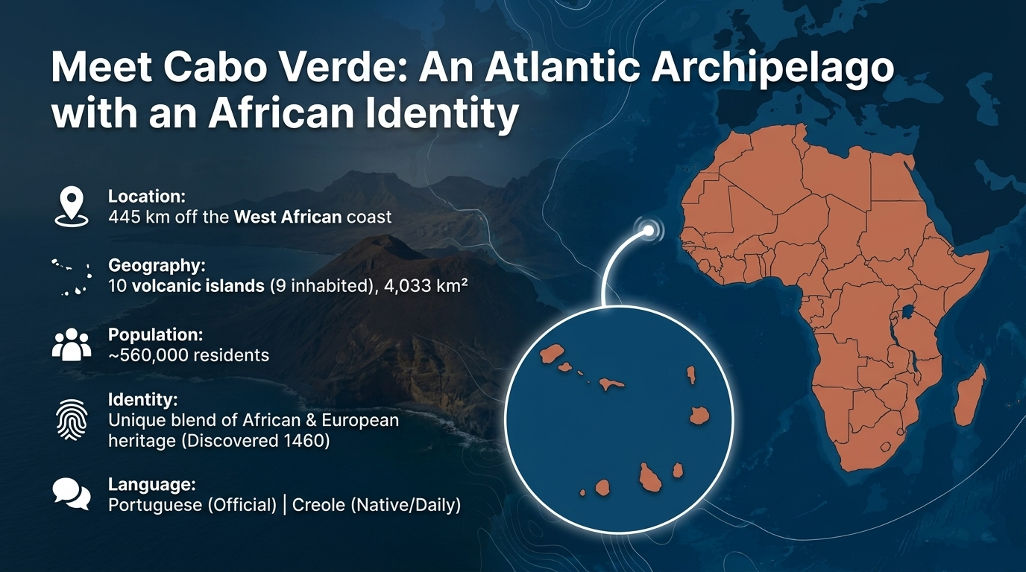
2

Slide 4
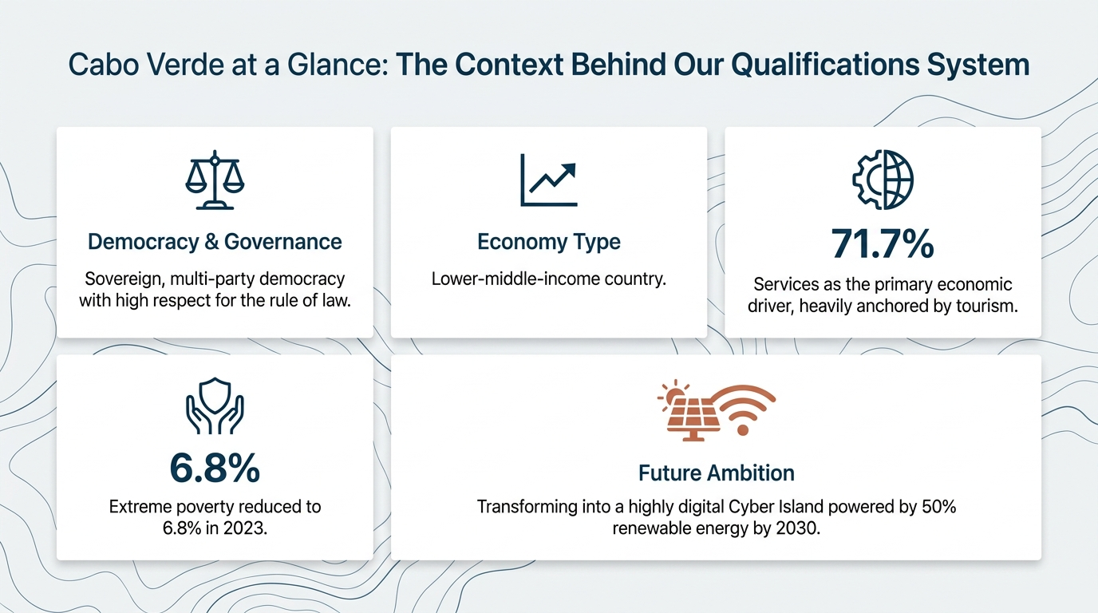
3

Slide 5
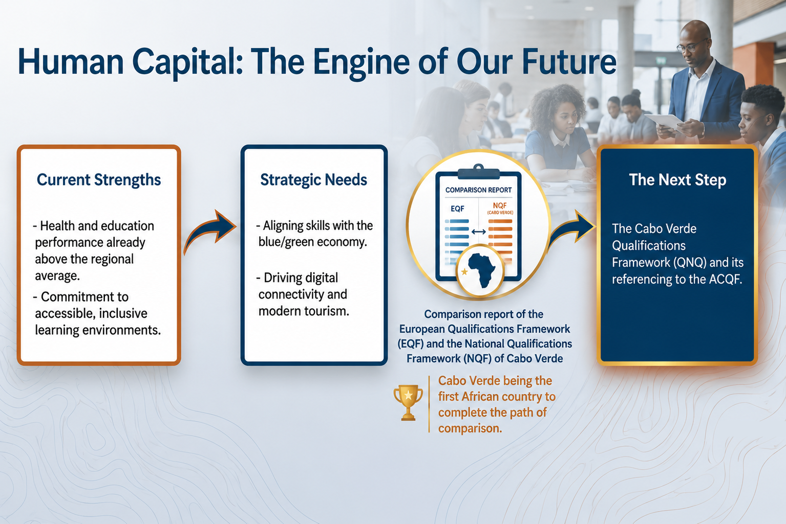
4

Slide 6
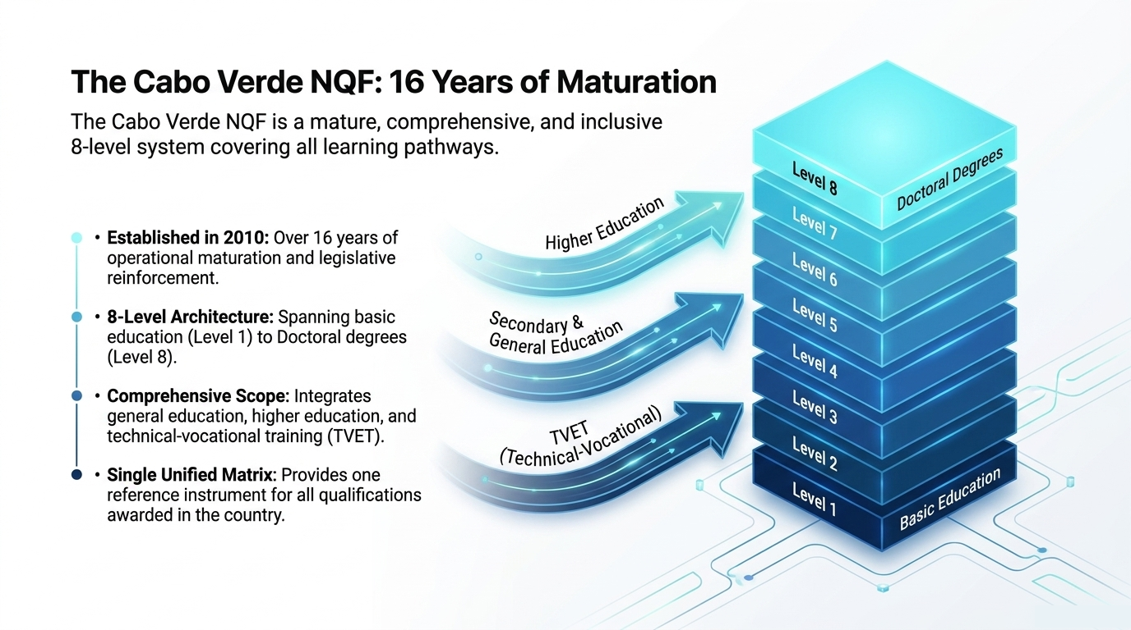
Cabo Verde Qualification System
5

Slide 7
ACQF RFERENCING CRITERION 1
LEVEL DESCRIPTORS
ARCHITECTURAL COMPARISON
STRUCTURAL RATIONALE
Because the Cabo Verde framework contains fewer levels, each individual level is structurally denser and incorporates higher expectations of autonomy, complexity, and innovation.
NQF
vs
ACQF
8
10
Absolute Parity at Lower Tiers
The architectural disparity does not compromise substantive alignment, rather, it reflects a difference in level density.
From NQF Levels 1 to 5, there is a near-absolute matching of vocabulary, operational complexity, and direct performance expectations.
Granular Stratification at Higher Tiers
8 LEVELS
10 LEVELS
At higher academic tiers, the ACQF distributes scientific complexity and frontier research across a more granular, stratified scale (ACQF Levels 7 to 10), whereas Cabo Verde compacts this spectrum within NQF Levels 7 and 8.
Cabo Verde
NQF Density
ACQF
Meta-Framework Scale
6

Slide 8











ACQF RFERENCING CRITERION 1
Methodology: How Level Descriptors Were Compared
01
Analytical Immersion
THECNICAL EVIDENCE
Comprehensive technical analysis of the level descriptors of both frameworks, broken down into the three core learning domains.
Core Analytical Basis
Learning Outcomes
02
Structural Alignment
Domain-specific descriptors
Rigorous semantic comparison to validate direct alignment across Knowledge, Skills, and Autonomy & Responsibility.
Official terminological rigor
03
Progression Mapping
Comparative Architecture
Assessment of the semantic progression of complexity across levels, ensuring symmetrical learning pathways.
Focus on technical density
8-level vs. 10-level scale
04
Articulation and Bridging
Substantive equivalence
Definition of technical equivalence bridges, justifying multiple correspondences based on the structural density of the national system.
7

Slide 9
ACQF RFERENCING CRITERION 1
DOMAINS OF LEARNING ALIGNMENT
Cabo Verde NQF Domains of Learning
ACQF Meta-Framework Domains of Learning
Established under Article 5 of the 2020 NQF legal text (Joint Order No. 10/2020), defining qualifications across three outcomes-based domains:
Structured as a 10-level scale representing learning complexity across three highly structured, outcomes-driven domains:
Knowledge: Facts, principles, theories, and practices from information assimilation.
Knowledge: Comprises type and scope of knowledge (including facts, principles, and theories).
The architectural disparity does not compromise substantive alignment, rather, it reflects a difference in level density.
Skills/Aptitudes: Cognitive (logical, intuitive, creative) and practical (manual tool use) capacities.
Skills: Addresses cognitive, practical, communication, social, digital, ecological (green), and innovation skills.
Responsibility & Autonomy (Attitudes): Applying personal, social, and methodological competences in work and study.
Autonomy & Responsibility : Defines context of application, extent of autonomy, and resource responsibility..
8

Slide 10
ACQF RFERENCING CRITERION 1
REFERENCING THE NQF TO THE ACQF
LEVELS CORREPONDENCE
Cabo Verde's foundational levels absorb and distribute basic operational complexity across the initial tiers of the continental framework.
Lower Tier Mapping
FOUNDATIONAL LEVELS 1 & 2
NQF Level 1 maps to ACQF Levels 1 & 2
Foundation Qualifications
Cabo Verde's Level 1 already requires "basic general knowledge" and "responsibility for one's own performance," surpassing ACQF Level 1 (basic literacy/numeracy under close instructions) and absorbing the operational complexity of ACQF Level 2.
Key awards linked to lower tiers
NQF Level 1
Diploma of Compulsory Basic Education (8 Years)
NQF Level 2 maps to ACQF Level 3
NQF Level 2
NQF Requires basic operational knowledge, verbal/written communication, and resolving routine problems using simple rules and tools. This aligns with ACQF Level 3, where action ceases to be purely automatic and demands informed technical choices.
Adult Basic Education Diploma (Double Certification)
9

Slide 11
ACQF RFERENCING CRITERION 1
Mid Tier Mapping
INTERMEDIATE LEVELS 3 TO 5
NQF 3 ACQF 4
NQF 4 ACQF 5
NQF 5 ACQF 6
NQF Level 3
NQF Level 4
NQF Level 5
Requires understanding of facts, processes, and general concepts with technical elements. Aligns with ACQF Level 4 by introducing technical advice, group work dynamics, and limited supervision.
Characterized by broad factual and theoretical knowledge in a field. Maps to ACQF Level 5, introducing intermediate planning, supervising others, and managing unpredictable situations with initiative.
Defined by highly specialized, factual, and theoretical knowledge (DESP/CESP).
Corresponds to ACQF Level 6, emphasizing creative abstract problem-solving and systemic resource management.
10

Slide 12

ACQF RFERENCING CRITERION 1
Higher Tier Mapping
Advanced Academic Pathways
NQF Level 6 maps to ACQF Level 7
Conferred by university and polytechnic Bachelor's Degrees. The correspondence of Cabo Verde NQF Level 6 to ACQF Level 7 is grounded in a strong structural alignment between both frameworks, driven by the high demand for innovation and technical leadership that characterizes the bachelor’s degree profile in the national system.
NQF Level 7 maps to ACQF Levels 8 & 9
Conferred by Master's Degrees. Because NQF Level 7 is structurally denser, it covers original research and reflection, spanning ACQF Level 8 and reaching the theoretical testing and mastery of ACQF Level 9.
NQF Level 8 maps to ACQF Level 10
Conferred by Doctoral Degrees. Demands cutting-edge frontier knowledge and transdisciplinary expertise, representing a substantial, original contribution to extend the global frontier of knowledge.
NQF 6, 7 & 8 Higher Education Mapping ARES Quality Assured University Degrees
1 / 8
11
/ Next Prev Toggle Notes

Slide 13
ACQF RFERENCING CRITERION 1
Translation Matrix
Table 1: THE REFERENCING MATRIX
NQF LEVEL (CV) | CORE QUALIFICATIONS AWARDED | ENTITIES RESPONSIBLE/SUB-SYSTEM | ACQF LEVEL | REFERENCING & TYPE LOGIC
 | Compulsory Basic Education (8 years) | National Directorate of Education (DNE) |  | Multiple: operational performance under supervision
 | Adult Basic Education (Double Certification) | DNE / UC-SNQ |  | Direct: operational knowledge, communication
 | Secondary Certificate (Grade 10/ TVET Level 3) | DNE / DGE / UC-SNQ |  | Direct: factual and technical, process knowledge
 | Secondary Certificate (Grade 12/ TVET Level 4) | DNE / DGE / UC-SNQ |  | Direct: broad technical, supervisory skills
 | Higher Professional Studies Diploma (DESP) | DGES / ARES / UC-SNQ |  | Direct: specialized factual & abstract skills
 | Bachelor's Degree (Licenciatura) | ARES/ Higher Education |  | Direct: complex professional activity innovation
 | Master's Degree (Mestrado) | ARES/ Higher Education |  | Multiple: advanced reseacrh and original reflection
 | Doctoral Degree | ARES/ Higher Education |  | Direct: frontier knowledge, original contribution
Level 1
Level 1 & 2
Level 2
Level 3
Level 3
Level 4
Level 4
Level 5
Level 5
Level 6
Level 6
Level 7
Level 7
Level 8 & 9
Level 8
Level 8
12

Slide 14













ACQF RFERENCING CRITERION 1
Evidence Supporting the Comparison
Legal and Structural Foundation
Correspondence Instrument
Transparency e Practice
Resultados de Aprendizagem
Joint Order No. 10/2020
Referencing Table 7
Order No. 18/2014
Cross-Semantic Analysis
Article 5 and Annex II formally establish the NQF architecture and national level descriptors.
Comprehensive technical mapping between NQF-CV and ACQF level descriptors
Implementation of the Diploma Supplement, ensuring international readability and comparability of qualifications.
Rigorous analysis of terminological progression and the cognitive complexity required at each level.
Legal definition of 8 levels
Domain-by-domain analysis
International alignment
Verification of autonomy
Categorisation into 3 learning domains
Justification of multiple
mapping pathways
Evidence of outcomes
Verificação de autonomia
CONCEPTUAL NOTE: DIFFERENCES IN SCOPE
The ACQF explicitly incorporates digital and green skills; the NQF-CV follows a classic domain categorisation. This difference in scope does not compromise substantive comparability, as the underlying technical complexity required across levels remains equivalent.
13

Slide 15














ACQF RFERENCING CRITERION 2:
Learning Outcomes, RPL, CREDIT SYSTEM
JOINT ORDER NO. 10/2020
LEGISLATIVE DECREE NO. 13/2018
Competence-based approach to qualification design
Transition to outcome and competence-oriented Higher Education
Learning Outcomes: The Central Pillar of the NQF
Conceptual Design
Assessment Criteria
Programme Evaluation
Foundation of the RPL/VNFIL System
Structuring units of competence within occupational profiles
Defining standards for formal, non-formal, and informal learning
Focus on learning outcomes achieved by learners in formal programmes.
Reference framework for the Validation of Non-Formal and Informal Learning (VNFIL / RPL).
1
2
3
4
OUTCOMES
ASSESSMENT
CERTIFICATION
QUALIFICATION
14

Slide 16




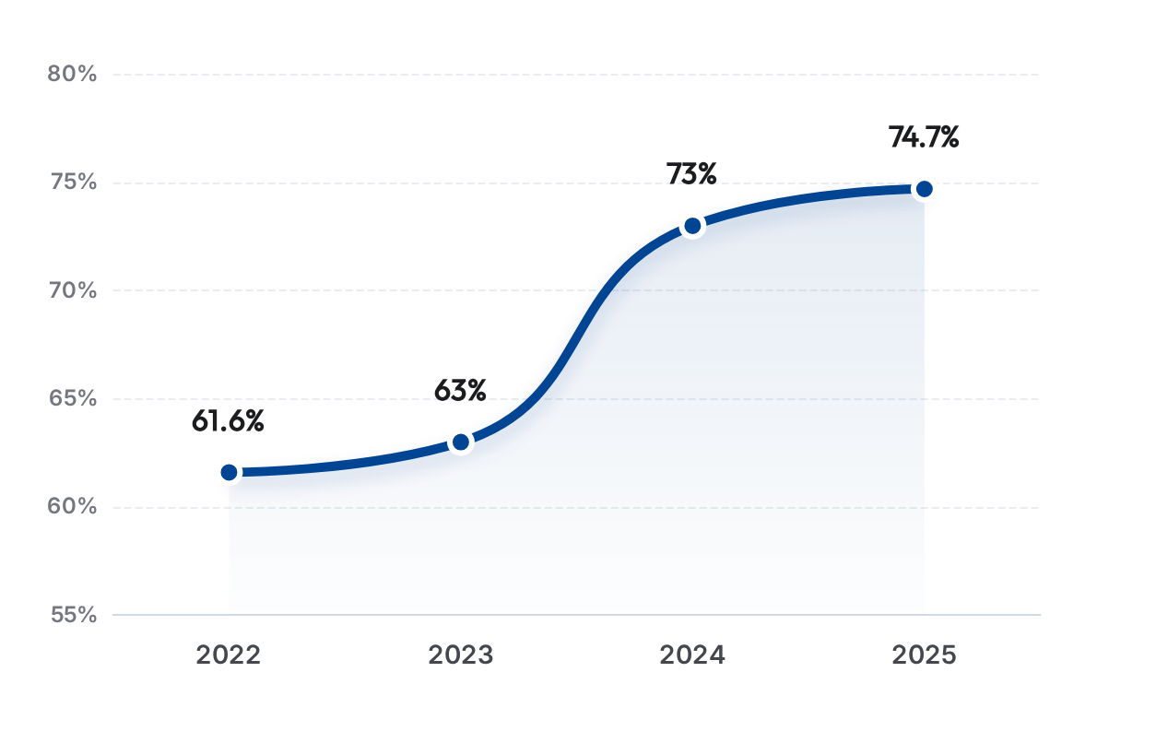




ACQF RFERENCING CRITERION 2:
Qualifications with Labour Market Value
NQS Approach
Labour Market Insertion Rate (%)
Broad, modular, competence-based qualifications adaptable to the constant evolution of economic sectors.
Validação Setorial
Close coordination with Sector Technical Committees (STCs) to ensure full alignment with real enterprise needs.
+13,1%
Growth in Labour Market Insertion (2022-2025)
15

Slide 17









ACQF RFERENCING CRITERION 2:
RPL (RVCC): Legal and Conceptual Framework
LEGAL BASIS
TARGET-GROUP
INTEGRATION
Age ≥ 25 years old | Experience ≥ 5 years
Core Component of SNQ / QNQ
Decree-Law No 54/2014
The 4-Stage Validation Process
01
IDENTIFICATION
Guidance and diagnostic mapping of acquired competences.
02
DOCUMENTATION
Compilation of evidence and portfolio development of prior learning.
03
ASSESSMENT
Technical verification by expert evaluation panels in accredited centres.
04
CERTIFICATION
Formal recognition with issuance of NQF-aligned certificates/diplomas.
Social Inclusion
Economic Productivity
Flexible Pathways
Alignment: EU Recomendation (2012) & Cedefop (2023)
16

Slide 18















ACQF RFERENCING CRITERION 2:
Implementation and Expansion of the RPL System
2022 • PILOT PHASE
2023 - 2025 • SCALLING UP
NQF SCOPE
Structural Launch
Territorial Expansion
Targeted Levels
Initial focus on 3 professional qualifications to validate methodology.
Focus on Sal Island and sectoral centres of excellence (EHTCV)
Institutionalised processes for intermediate technical levels.
48 Certificates
520+ Certificados (Sal island)
LEVELS 3, 4 E 5
Priority Occupational Families
Technical Capacity Building
≈ 50
Installation and Maintenance
Administration and Management
Trained RPL specialists operational within the system:
Hospitality and Tourism
Facilitators
Advisors
Assessors
17

Slide 19


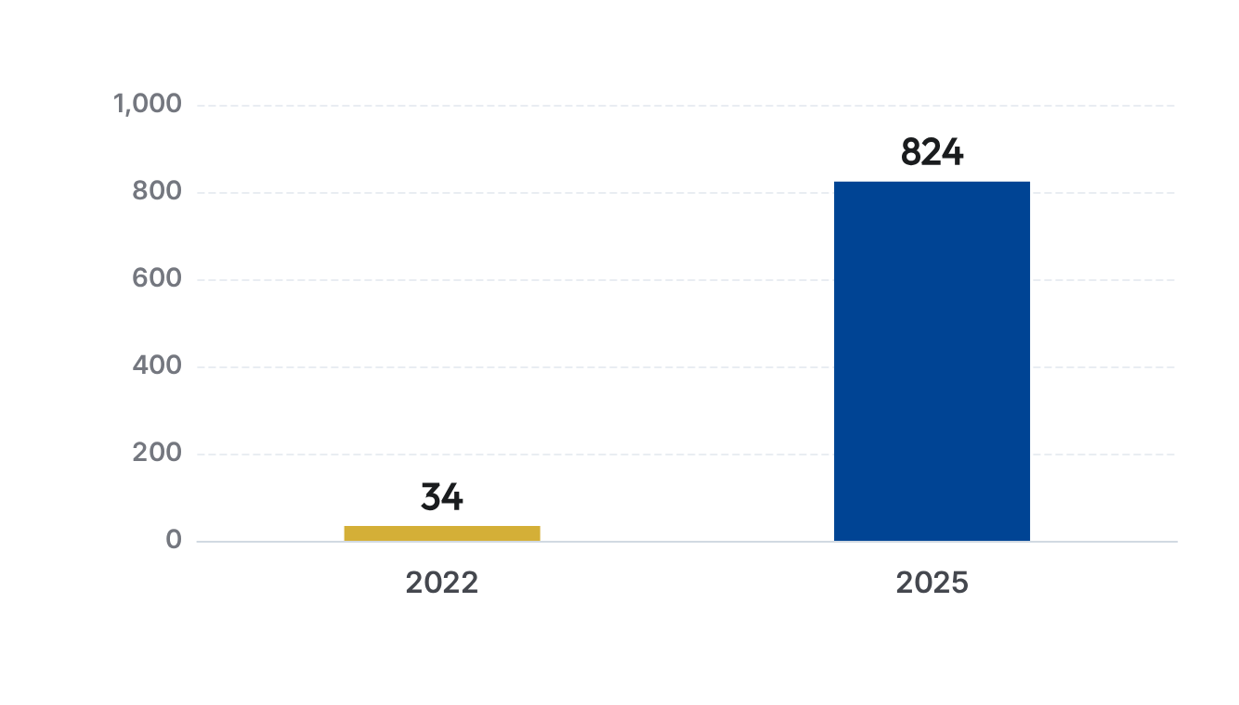



ACQF RFERENCING CRITERION 2:
RPL – Exponential Growth in Certification
+2423%
Scaling-Up Strategy
3-Year Growth
Successful transition from the pilot phase (34 certificates in 2022) to a robust national scale, reaching 824 beneficiaries in 2025.
Collaborative Ecosystem
Success driven by coordination between the Government, private enterprises, and accredited public and private training centres.
Data source: NQS Coordination Unit (UC-SNQ) • July 2026
18

Slide 20














ACQF RFERENCING CRITERION 2:
Credit System and Learner Mobility
Higher Education
TVET (Technical and Vocational Education
and Training)
Consolidated structure based on study.
Implementation of academic credits for accumulation and transfer (Decree-Law No. 13/2018).
Modular structure enabling progressive accumulation of units of competence throughout working life.
ECTS Alignment
Gap: Absence of formal credit transfer guidelines
LEARNING PATHWAYS AND NQF PERMEABILITY
7
8
6
4
5
2
3
Bachelor’s Degree
Master’s Degree
Doctoral Degree
1
Short-Cycle
HE
Vocational
Technical
Basic
Basic II
MODULAR ACUMULATION
ACADEMIC PERMEABILITY
CREDIT TRANSFER
TVET (Unit-Based Credits)
TVET (Unit-Based Credits)
Higher Education (ECTS Credits)
Critical Transition Zone
19

Slide 21











ACQF RFERENCING CRITERION 2:
Evidence of Alignment with the ACQF
CRITERIO 2 DIMENSION
LEGISLATIVE / INSTITUTIONAL EVIDENCE
INDICATOR/ IMPACT DATA
Learning Outcomes Foundation
Joint Order No. 10/2020
Competency Based Approach
Legislative Decree No. 13/2018 (Higher Education)
Recognition of Prior Learning (RPL/RVCC)
Decree-Law No. 54/2014
Integrated National System
NQS Coordination Unit (UC-SNQ)
Outcomes and External Efficiency
UC-SNQ Monitoring Data
74,7% Labour Market Insertion Rate (2025)
Scaled-Up Certification System
Methodological Alignment
4-Stage RPL Process (EU/ACQF-Aligned)
ACQF Continental Standard
Cedefop Guidelines (2023)
Governance and Partnership
Sector Technical Committees (STCs)
Active Sectoral Validation
Rede de Centros Públicos e Privados
20

Slide 22










ACQF RFERENCING CRITERION 2
Synthesis: Progress, Challenges and Way Forward
PROGRESS
CHALLENGES
WAY FORWARD
TVET Maturity
Higher Education in Transition
Diplomas Alignment
Consolidated system based on competences and learning outcomes.
Academic diplomas do not yet explicitly indicate the NQF level
Full integration of NQF levels into all academic qualifications.
RPL in Higher Education
RPL Expansion
RPL Scalling-Up
Recognition pathways still inoperative for higher education levels.
Implementation of validation mechanisms in Higher Education.
Successful transition from pilot projects to national scale (824 certificates).
TVET Credit System
Integrated Credit System
Employment Rate
Absence of formal guidelines for credit accumulation and transfer
Establishment of transparent guidelines for mobility and progression.
Robust growth in labour market insertion, reaching 74.7% in 2025.
ACQF Convergence
Institutional Collaboration
Pathway Permeability
Consolidation of a lifelong learning ecosystem.
Effective coordination between Government, STCs, and Training Centres
Need for greater flexibility between sub-sectors of the system.
21

Slide 23








ACQF RFERENCING CRITERION 3
TRANSPARENCY IN
INCLUSION OF
QUALIFICATIONS IN NQF
Acessível
Reliable
Verifiable
Public availability of qualification data.
Information based on rigorous validation processes.
National register enabling confirmation of legitimacy.
Open access for citizens, employers, and partners.
Quality assurance in assigning NQF levels.
Traceability of qualification pathways and levels.
Simplified consultation via digital platforms.
Updated data managed by competent authorities.
Clear alignment with level descriptors.
22

Slide 24










ACQF RFERENCING CRITERION 3
A Transparent Process Generates Credible Qualifications and a Trusted NQF
Institutional Trust
Robust legal foundation and rigorous validation processes ensuring system integrity.
Digital Ecossystem
Public platforms (CNQ, PD-ARES, Krê+) guaranteeing accessibility and instant verification.
Continental Alignment
Cabo Verde demonstrates that transparency is not merely a policy statement, it is fully operationalised through legislation, methodologies, institutions, and digital platforms.
Full compliance with ACQF criteria, facilitating mobility and international recognition.
Continuous Evolution
Foco futuro na unificação de registos e na expansão da inteligência de dados para políticas setoriais.
23

Slide 25













ACQF RFERENCING CRITERION 4
QUALITY ASSURANCE
The Foundation of Trust in the National Qualifications Framework of Cabo Verde
Transparency
Mobility
Confiança Mútua
Makes qualification processes clear and auditable for all social and economic partners.
Facilitates the recognition of competences and the mobility of learners and workers across the African continent.
Ensures alignment between education and training provision and skill demand in the labour market.
24

Slide 26













ACQF RFERENCING CRITERION 4
Architecture of the Quality Assurance System in Cabo Verde
COORDINATION AND REFERENCING FLOWS
REGULATORY BODIES
Technical and Vocational Education and Training
DGE
Levels 1-5
Directorate General for Employment (TVET)
Provider accreditation via PAEF; validation of qualifications by Sector Technical Committees (STCs) and Sector Councils (COS).
ARES
NQF – NATIONAL QUALIFICATION FRAMEWORK
Agency for Regulation and Quality Assurance
in Higher Education
Higher Education
Legal Frameworks for QA
Levels 5-8
Joint Order No. 9/2020 and 10/2020 (NQC/NQF)
Institutional and study cycle evaluation via PD-ARES. Self-assessment and independent external evaluation.
Decree-Law No. 6/2013 (TVET Accreditation)
Law No. 121/VIII/2016 (Establishment of ARES)
Systemic Coeherence: Coordination ensures that QA processes in both sub-sectors converge toward transparency and trust in the NQF
Decree-Law No. 20/2012 and 16/2026 (Higher Education)
25

Slide 27
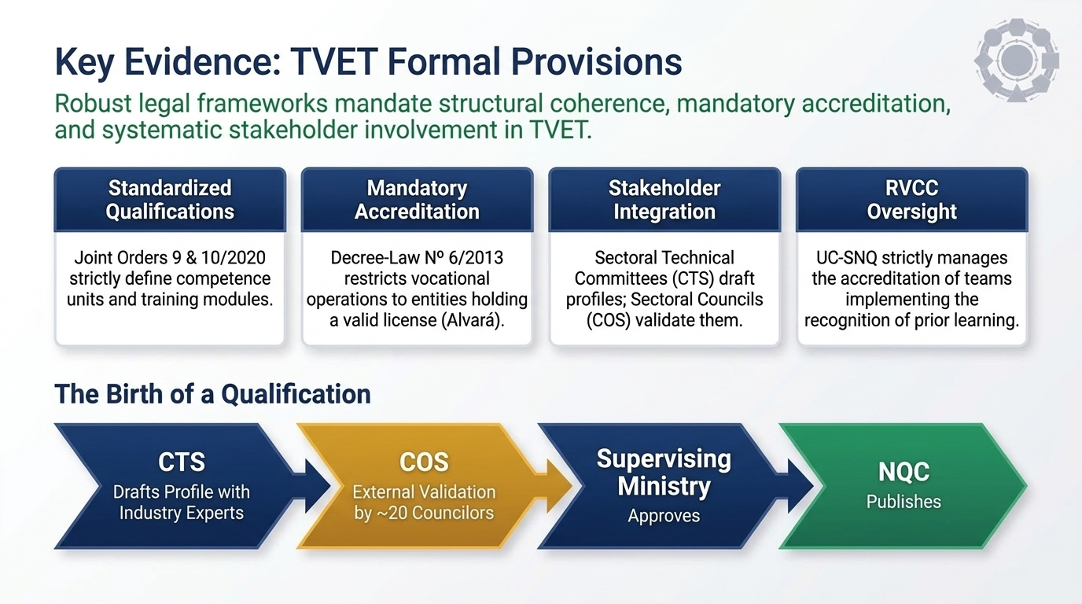
26

Slide 28
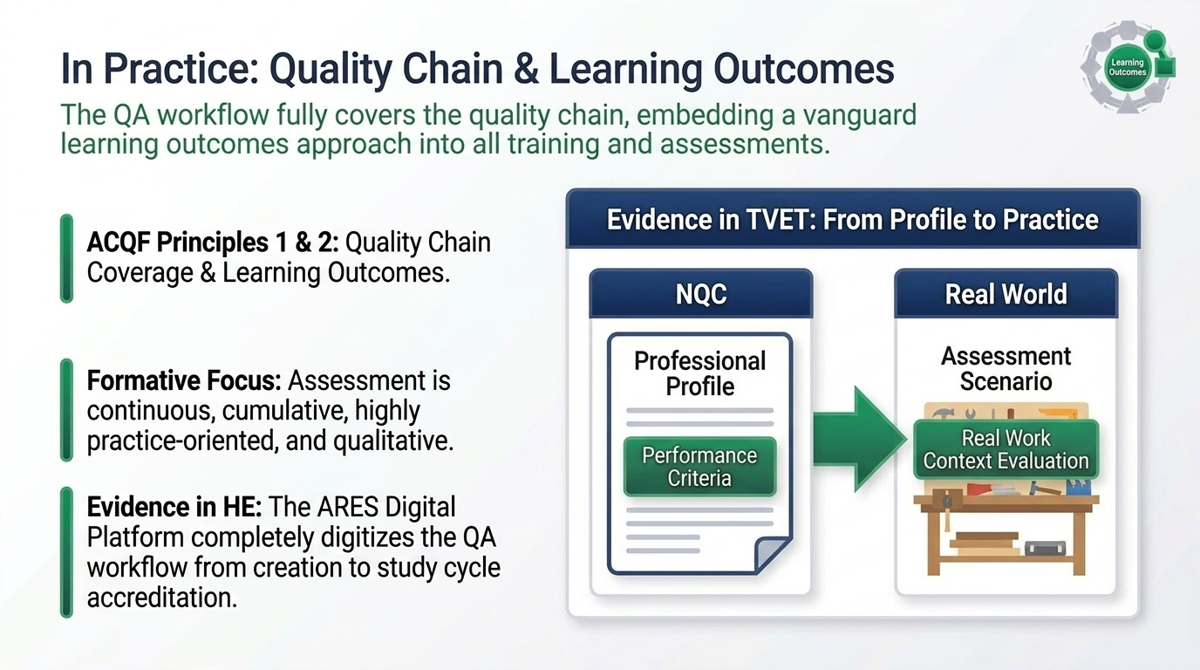
27

Slide 29
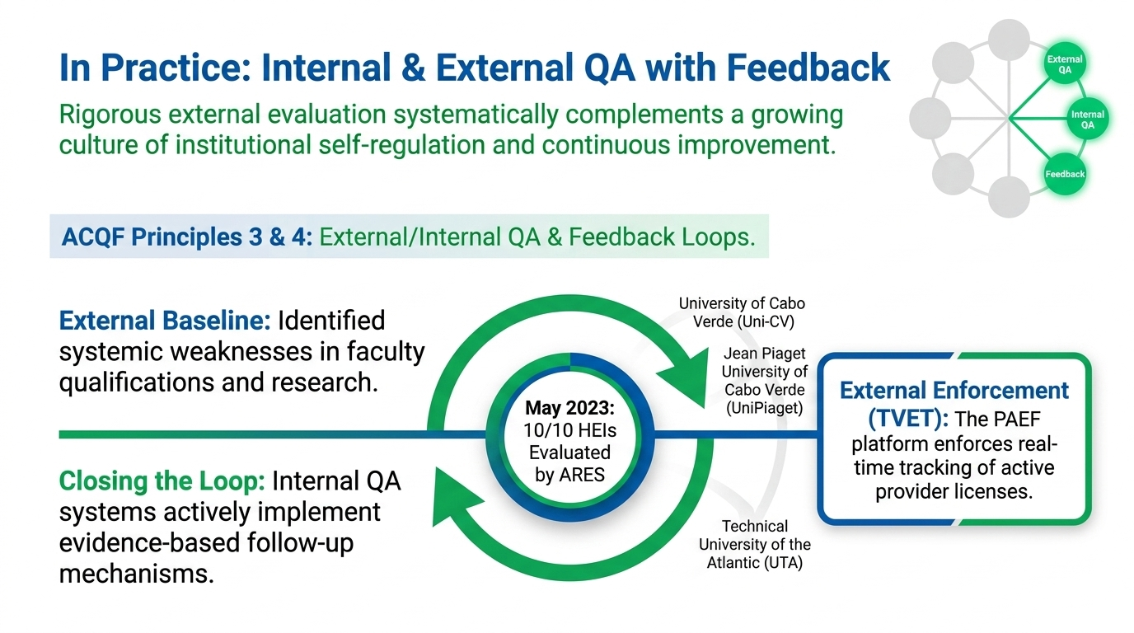
28

Slide 30
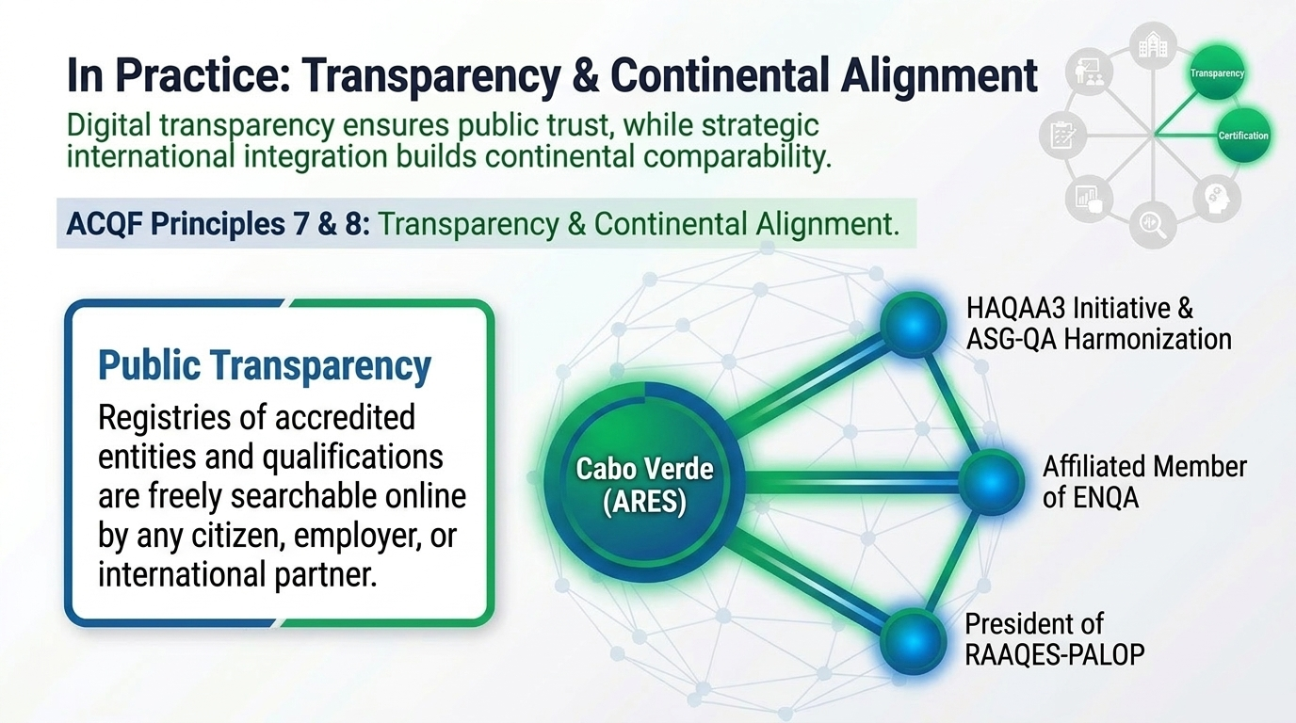
29

Slide 31
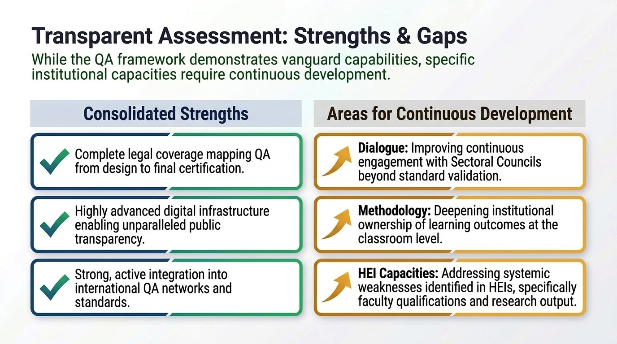
30

Slide 32
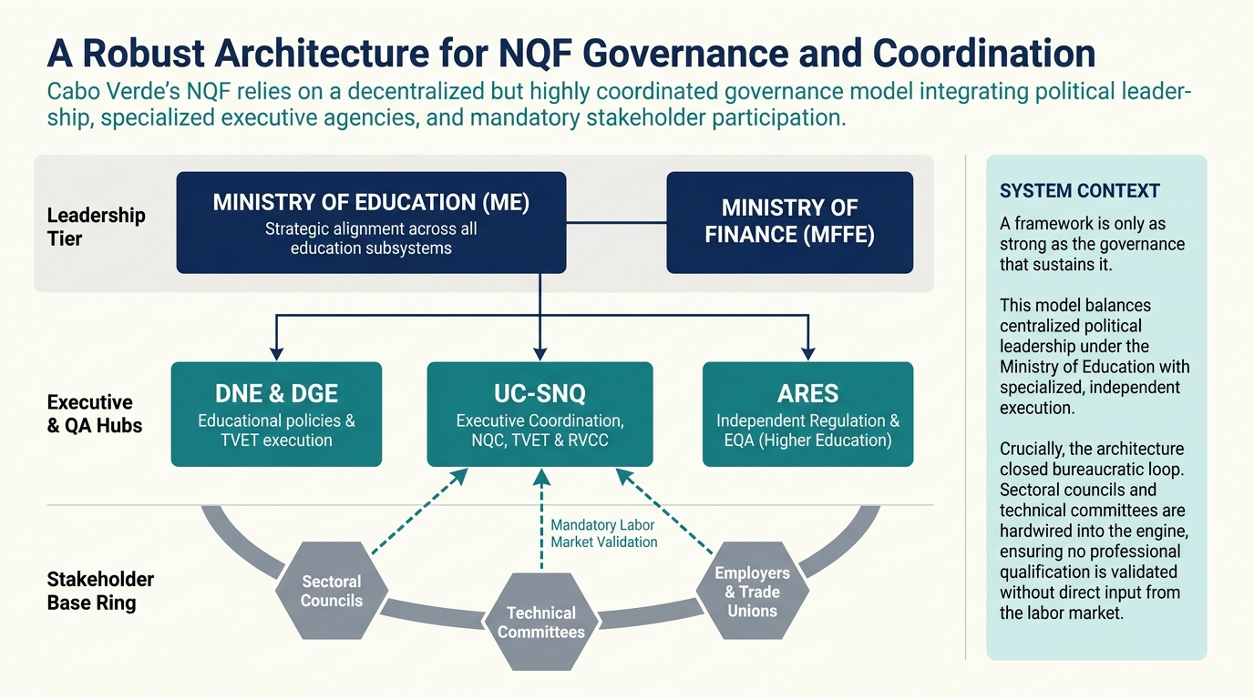
31

Slide 33
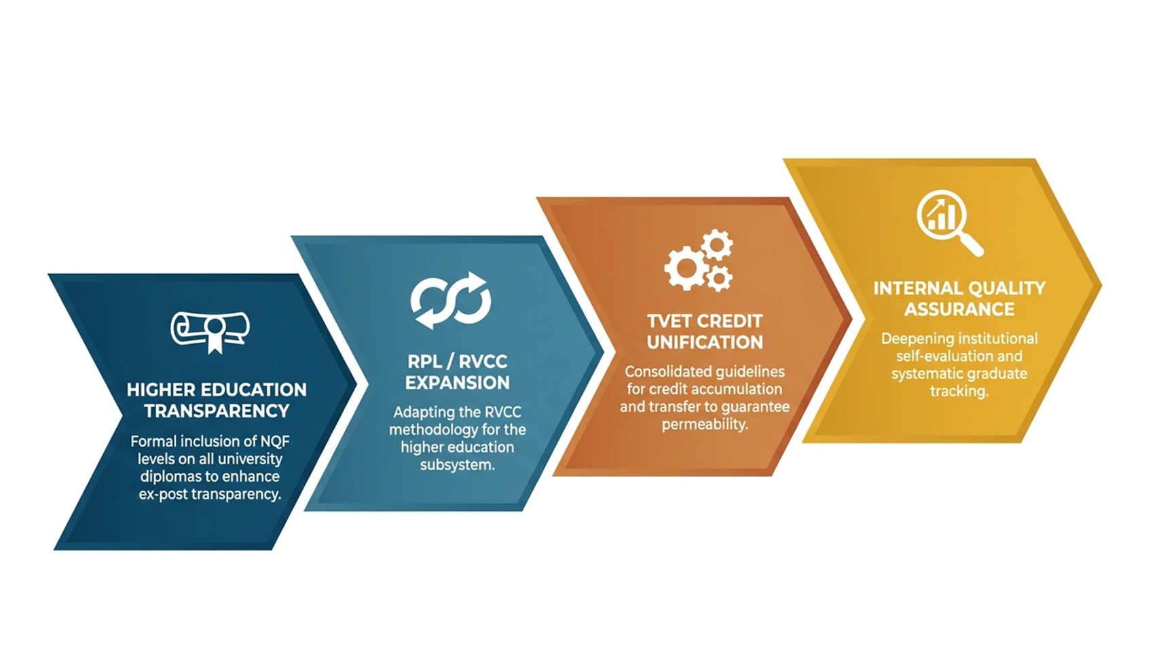
CHALLENGES TO ADDRES:
FROM REFERENCING TO ACTION
32

Slide 34
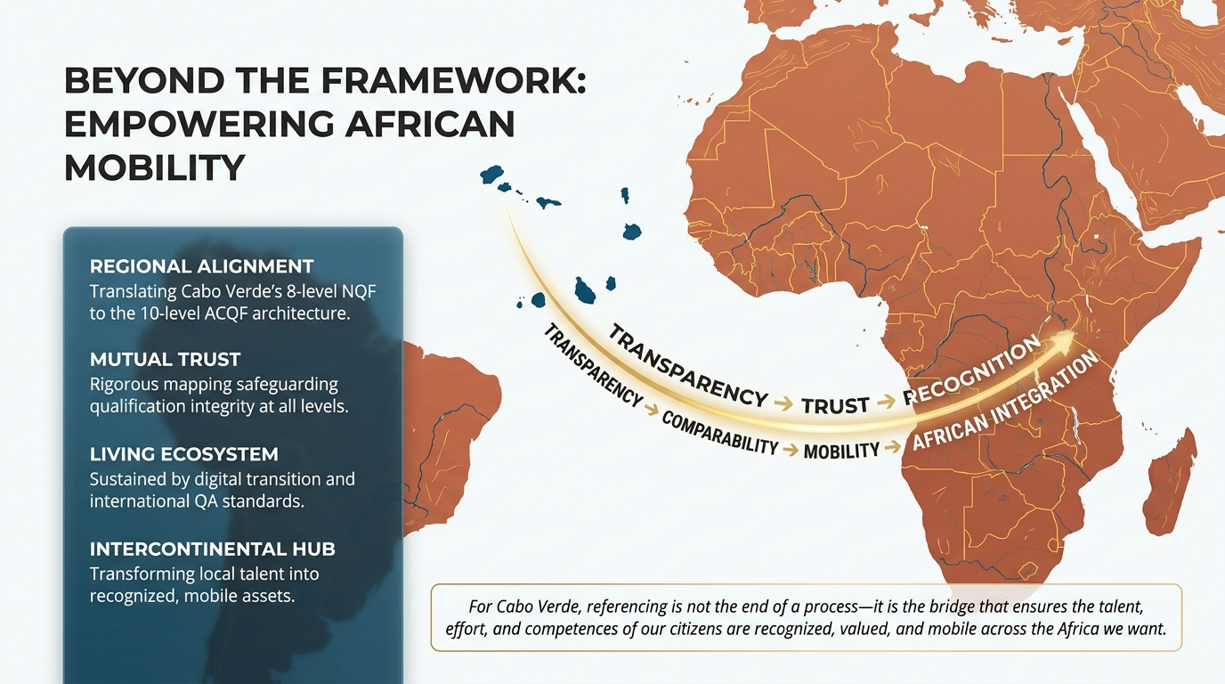
33

Slide 35


